Slide 1
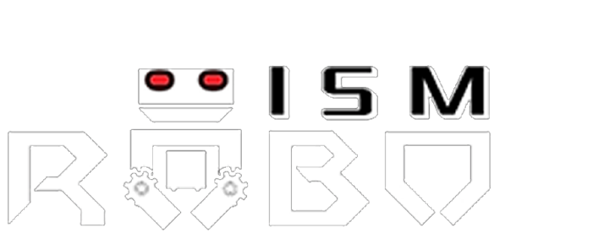
ATULYA
Name: Debarun Chakrabortty
Admn no: 21JE0281
Division: Internet Of Things(IOT)
Project : Smart irrigation System

Slide 2
Introduction
The raising population demands higher agriculture production.Irrigated agriculture becomes a very important resource.
Specific crops require certain moisture levels of soil to grow properly and give a good yield .
This presentation focuses upon providing a “Smart Irrigation System” based on IOT.
Here the idea is just pitched and future improvements can be done to the project.

Slide 3
Objectives
Detecting the soil moisture content and sprinkling water according to it.
Reducing manpower and developing a accurate system to monitor the watering and growth of crops.
Real time sensing and control.

Slide 4
Components
Arduino Uno
Servo motor
Soil moisture sensor
Mini water pump
Relay module
Connecting wires
Breadboard

Slide 5
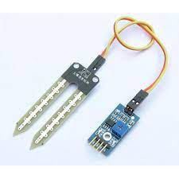
Soil moisture sensor
The soil moisture sensor is one kind of sensor used to gauge the volumetric content of water within the soil.

Slide 6
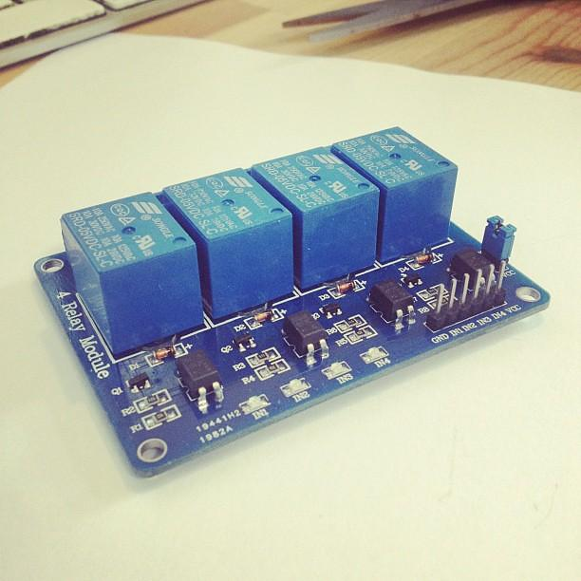
Relay module
The relay is the device that opens or closes the contacts to cause the operation of the other electric control.

Slide 7
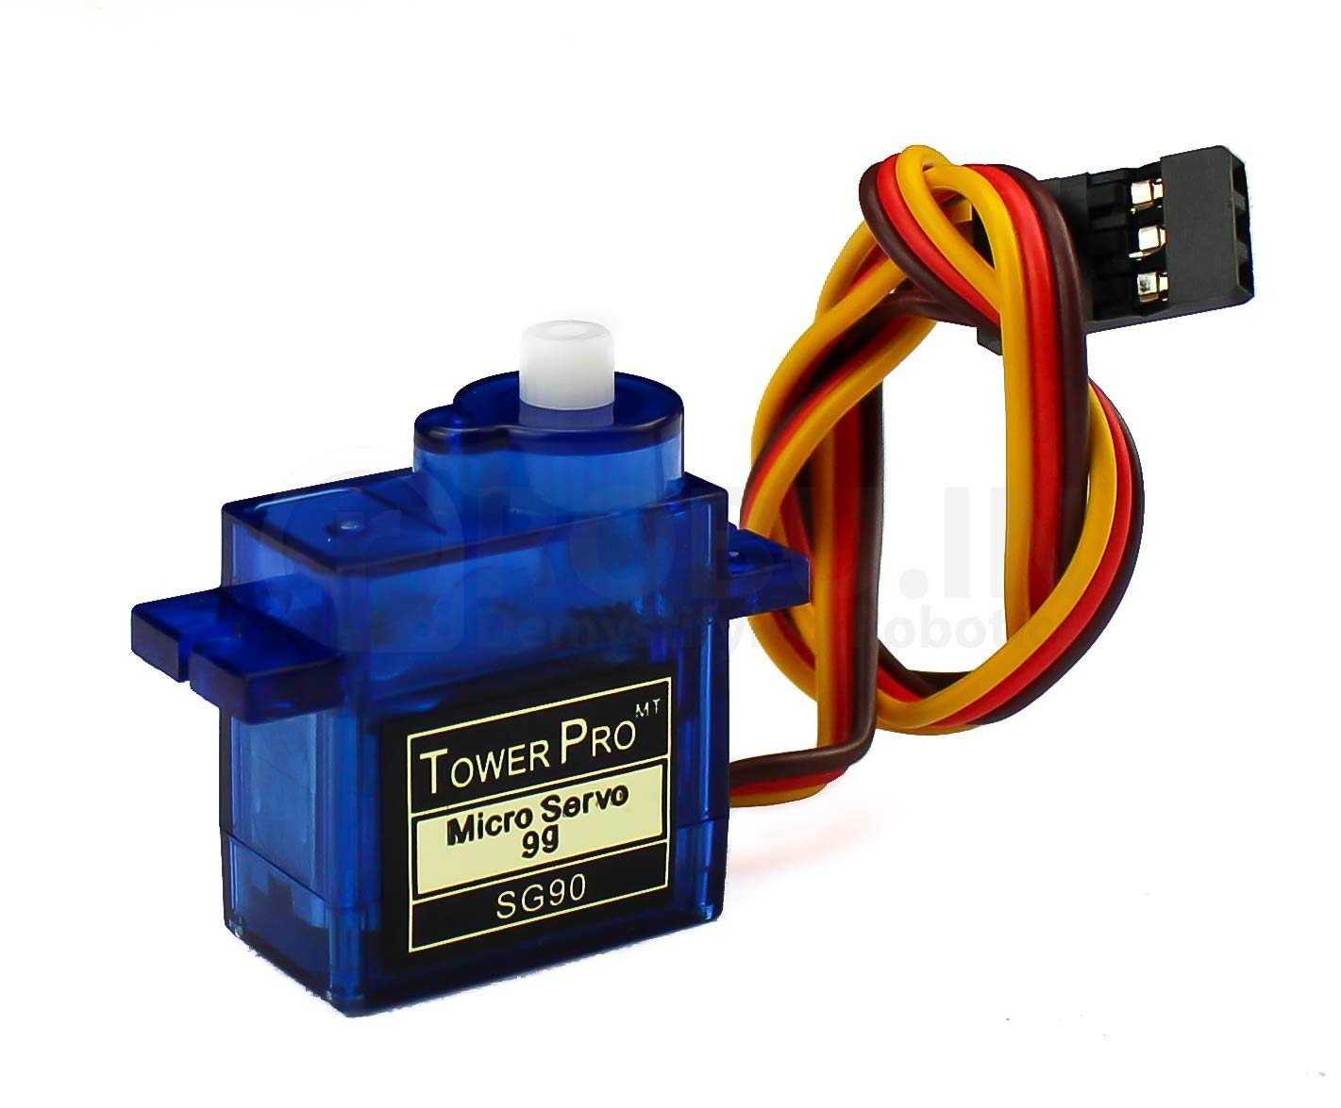
Servo Motor
A servo motor is a rotary actuator that allows for precise control of angular position.

Slide 8
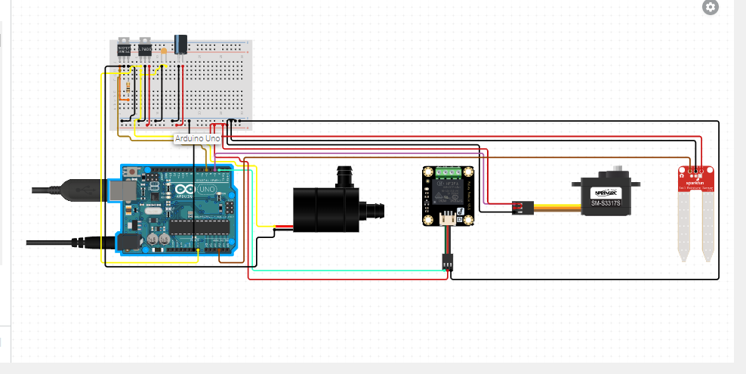
Connection and circuit diagram

Slide 9
Block Diagram
Water Pump
Soil moisture sensor
Arduino Uno
Relay module
Servo Motor

Slide 10
Block Diagram
Moisture sensor attains the data from the soil
The data is fed in the arduino where it is processed
Start of process
Water pump is turned ON or OFF accordingly
The data is then analyzed with the parameters in the code
If m<=970 then relay is ON
Else if m>=980 then relay is OFF
End of process

Slide 11
Future prospects of project
Instead of just having a single soil moisture sensor we can include multiple soil water sensors to cover a larger area of land.
A temperature and humidity sensor can be include in the project.Both the factors play a significant role in the crops harvest .Plants are also kept healthy by maintaining temperature and humidity under specified ranges.
A light sensor can be added to the module to detect the amount of sunlight received by the crops and plan there irrigation accordingly.

Slide 12
Resources
https://ieeexplore.ieee.org/abstract/document/9604699
https://www.circuito.io/app?components=512,11021
https://www.elprocus.com/soil-moisture-sensor-working-and-applications/
https://behrtech.com/blog/top-10-iot-sensor-types/
Github link of code
https://github.com/Debarunn1806/-Debarun-Chakrabortty-21JE0281-IOT-

Slide 13
Thank You

